Slide 1
Sega Dreamcast
System Overview
John Byrd
Sega of America
Notes:
Your notes here.

Slide 2
Overview 1
Buses and memory
Graphics
CPU

Slide 3
Overview 2
Storage
Modem
Audio

Slide 4
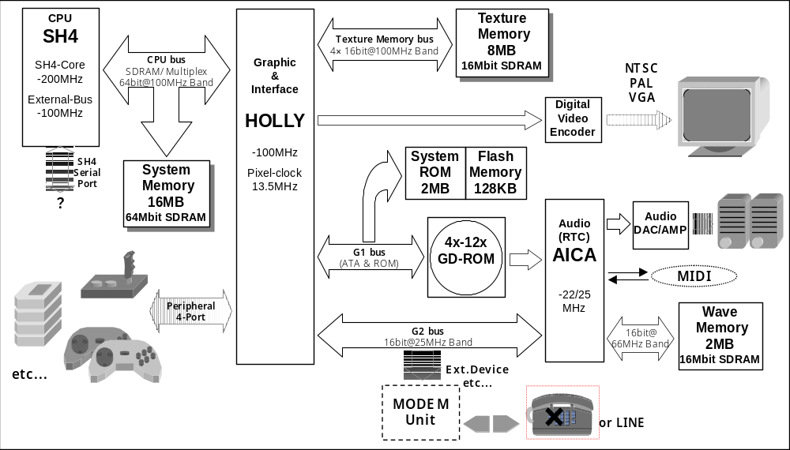
Notes:
In order to make the best use of the performance capabilities of the SH4, SDRAM is used for the main system memory, and is connected directly to the SH4. There are 16MB of main memory, the bus width is 64 bits, and the operating frequency is 100MHz. The (theoretical) maximum burst transfer speed is 800MB/s. In addition, aside from DMA transfers from the graphics and the interface chip, this system memory is used only by the SH4. 7ns chips or the equivalent are used for this memory
The GD-ROM drive that is built into the KATANA system is used to load sound data as well as data that is used by the game software, etc. The GD-ROM drive supports various CD formats, and rotates according to the CAV system. The data reading speed ranges from 4x to 12x. An ATAPI device is used for the drive.
Supported by the HOLLY's internal PowerVR core, this is an SDRAM interface bus for texture memory, which is memory that is used for drawing and display functions. The bus clock is 100MHz, and the bus width is 64 bits (16 bits x 4). The G1 bus is supported by HOLLY. The GD-ROM, system ROM, flash memory and other asynchronous devices are connected to the G1 bus in parallel. The access method used on the G1 bus differs according to the target device, with accesses to the GD-ROM device being different from accesses to system ROM or flash memory. Access is based on the ATA standard, according to a protocol that supports the ATA standard in part. One interrupt line from the GD-ROM is supported. Regarding data transfers, DMA transfers are possible in the GD-ROM area. This G1 bus also supports the loading of 8 bits of data (a country code) that are set on the board.
The G2 bus is supported by HOLLY. This bus supports the audio chip AICA, a modem, external devices, and other synchronous devices. The G2 bus is basically a PCI-like bus, with a bus clock of 25MHz and a bus width of 16 bits. The bus supports three interrupt lines, one for each of the supported devices listed above. Aside from the modem, DMA transfer is possible with the AICA and external devices.

Slide 5
Buses
CPU bus
  100 MHz, 64 bits (2 SDRAM banks x 32)
Texture memory bus
  100 MHz, 64 bits (4 SDRAM banks x 16)
Wave memory bus
  67.7MHz, 16 bits
G1 bus: GD-ROM, system ROM, flash
G2 bus: audio, modem, external devices
  8 byte FIFO on writes from SH-4
Notes:
The CPU bus connects the SH4, the CPU, to the 16MB system memory and to "HOLLY," the graphics/interface core. Between the CPU and system memory, this is an SDRAM interface with a 64-bit data width, and between the CPU and HOLLY, this is a 64-bit bus interface on which addresses and data are multiplexed. As mentioned on the previous page, the bus clock in both cases is 100MHz.
The SH4 uses two different bus protocols on the CPU buses, depending on the memory area that has been mapped. One of the following two choices is selected, depending on memory area is to be accessed:
(1) Direct operation to SDRAM
(2) MPX operation to HOLLY
A "Direct operation to SDRAM" is an operation that is performed once the SH4 is directly connected to SDRAM, the system memory. The address and data buses form the interface with SDRAM. Area 3 (of the seven physical memory area divisions in the SH4) is used, and memory access is possible in bank active mode. Note that this type of access does not use the upper address bits (A[25:17]).
An "MPX operation to HOLLY" is an operation that multiplexes the address and data on the 64-bit data bus.
Supported by the HOLLY's internal PowerVR core, the texture memory bus is an SDRAM interface bus for texture memory, which is memory that is used for drawing and display functions. The bus clock is 100MHz, and the bus width is 64 bits (16 bits x 4).
Wave memory bus: This is an SDRAM interface bus for audio that is supported by AICA. The bus clock is 67.7MHz (2 x 33.8688MHz, which is supplied from the GD-ROM to AICA). The bus width is 16 bits.
The G1 bus is supported by HOLLY. The GD-ROM, system ROM, flash memory and other asynchronous devices are connected to the G1 bus in parallel. The access method used on the G1 bus differs according to the target device, with accesses to the GD-ROM device being different from accesses to system ROM or flash memory. Access is based on the ATA standard, according to a protocol that supports the ATA standard in part. One interrupt line from the GD-ROM is supported. Regarding data transfers, DMA transfers are possible in the GD-ROM area. The SH-4 can only access 4 bytes at a time from G1.
The G2 bus is supported by HOLLY. This bus supports the audio chip AICA, a modem, external devices, and other synchronous devices. The G2 bus is basically a PCI-like bus, with a bus clock of 25MHz and a bus width of 16 bits. The bus supports three interrupt lines, one for each of the supported devices listed above. Aside from the modem, DMA transfer is possible with the AICA and external devices.

Slide 6
Memory
16 MB SDRAM directly accessible by SH-4
  100 MHz bus, 64 bits wide, <= 7 ns access time
  2 x 64 Mbits SDRAMs
2 MB system ROM
128 KB flash memory
8 MB texture memory
Notes:
In order to make the best use of the performance capabilities of the SH4, SDRAM is used for the main system memory, and is connected directly to the SH4. There are 16MB of main memory, the bus width is 64 bits, and the operating frequency is 100MHz. The (theoretical) maximum burst transfer speed is 800MB/s. In addition, aside from DMA transfers from the graphics and the interface chip, this system memory is used only by the SH4. 7ns chips or the equivalent are used for this memory.
The KATANA System also has 2MB of system ROM, where the operating system, boot routine, etc., are stored.

Slide 7
Memory: DMA
Most major data moving occurs via SH-4’s four DMA controllers
  32 aligned bytes per bus transaction
  Write-only vs. system to system
  Uses burst mode, 32 bytes per transaction
  Contrast “cycle steal” mode for channels 1 and 3
  However, due to hardware problems, try not to interrupt an ongoing DMA
See sg_cp.h
Notes:
There are two basic types of DMA in this system. There is write-only DMA, which can transfer texture data or display lists (polygon parameters) quickly from system memory to texture memory via the TA Bus of the HOLY internal block bus, and DMA for transfers via the Root Bus.
In addition, there are two types of DMA that use the TA Bus: ch2-DMA and Sort-DMA. ch2-DMA is used to transfer texture data and display lists. Sort-DMA is used to presort display lists in the CPU and then transfer the data in accordance with that list.
There are two methods for transferring display lists (polygon parameters): a method that uses ch2-DMA and a method that uses Sort-DMA (ch0:DDT).
The DMAC-related settings are described below.
(1) DMAC uses DDT mode.
(2) Because DMA channel 0 is used by the hardware, use by the software is prohibited. (The DMA end interrupt cannot be used.)
(3) DMA operations are performed on channel 2 as a set with ch2-DMA of the HOLLY chip. (The SH4's DMAC channel 2 register must be controlled by software at the same time.) Channel 2 DMA depends on the following settings.
E Transfer data length: Only 32-byte block transfer is permitted.
E Address mode: Only single address mode is permitted.
E Transfer initiation request: Only external requests (external address space -> external device) are permitted.
E Bus mode: Only burst mode is permitted.
E DMA end interrupt: Generation of both SH4:DMAC and HOLLY:ch2-DMA is permitted.  Select one or the other. (If two are enabled, it will just result in interrupts being generated twice.)
(4) Channels 1 and 3 can be used in the following manner:
E The allowed transfer data length (8/16/32 bits, 32 bytes) depends on the transfer area. The 64-bit transfer data length specification is permitted only for system memory.
Address mode: Only dual address mode is permitted.
Transfer initiation request: SCIF interrupt and auto request are permitted.
Bus mode: Only cycle steal mode is permitted.
DMA end interrupt: Can be used.
There are six types of DMA that use the Root Bus: PVR-DMA, GD-DMA, AICA-DMA, Ext-DMA1, Ext-DMA2, and Maple-DMA. 32 bytes can be transferred in one DMA transfer operation.
ch2-DMA permits fast data transfer from system memory to texture memory. ch2-DMA cannot be used in the reverse direction, for transfers from texture memory to system memory.
ch0 > ch2 > ch3 > ch1

Slide 8
Memory: access
All devices are memory mapped to SH-4
  0x00000000 - 0x03FFFFFF
    system devices, 1-4 bytes/access
  0x04000000 - 0x07FFFFFF
    texture memory, 4 or 32 bytes/access

Slide 9
Memory: access
  0x0C000000 - 0x0CFFFFFF
    system memory, 4 or 32 bytes/access
    same memory as 0x8C000000 - 0x8CFFFFFF, but MMU is on
    same memory as 0xAC000000 - 0xACFFFFFF, but caching is on
  0x10000000 - 0x107FFFFFF
    tile accelerator, 32 bytes/access (write only)

Slide 10
Memory: access
  0x10800000 - 0x11FFFFFF
    texture memory, 32 bytes/access (write only)
  0x14000000 - 0x17FFFFFF
    G2 devices, 1-4 bytes/access
  0x1C000000 - 0x1FFFFFFF
    SH-4 control registers

Slide 11
Memory: real application performance
Audio memory access ~40x slower than system memory from SH-4
Direct SH-4 writes to texture memory are ~10x-15x slower than DMA

Slide 12
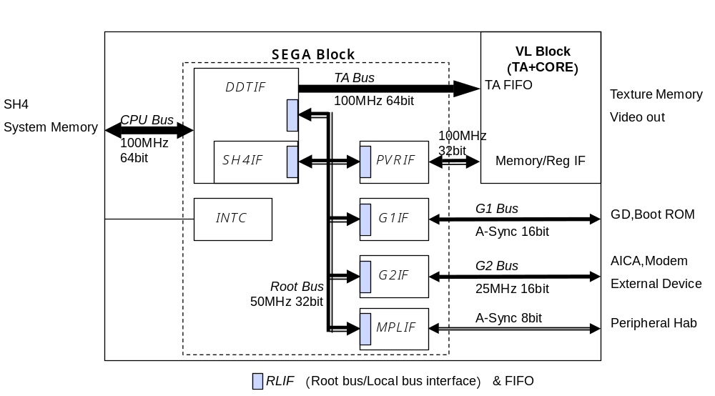
Graphics core

Slide 13
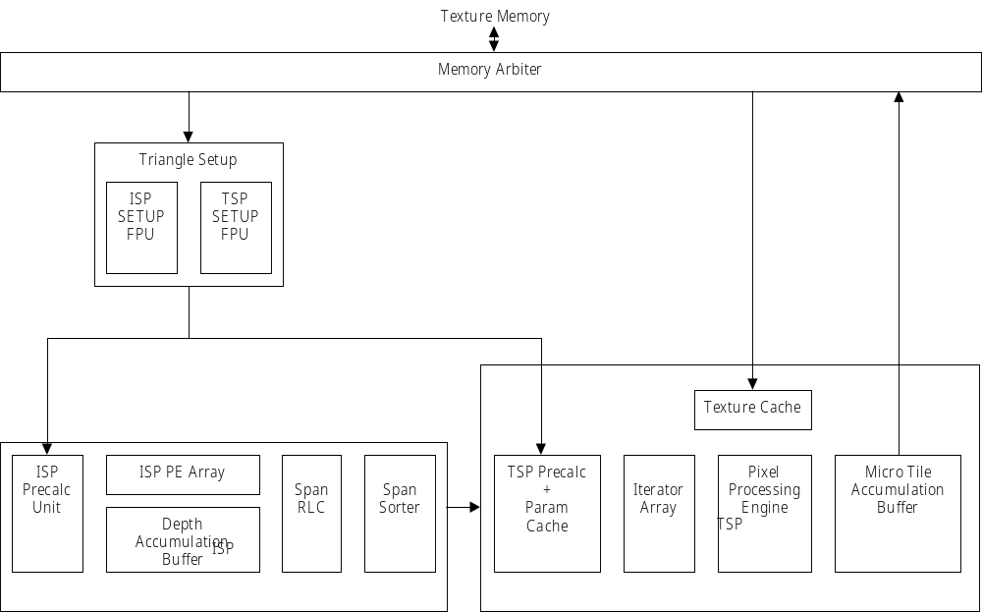

Slide 14
Graphics core
Codename: Holly
Contains tile accelerator and drawing functions
100 MHz clock

Slide 15
Graphics process flow
◆Flow of Processing (KATANA)
Modeling
Geometry
Processing
Tile divided
small area
Hidden surface
removal
by tiling
Texture
mapping
shading
Rendering to
frame buffer
Tile
Accelerator
ISP
TSP
Processing by SH4
Processing by PoweVR2

Slide 16
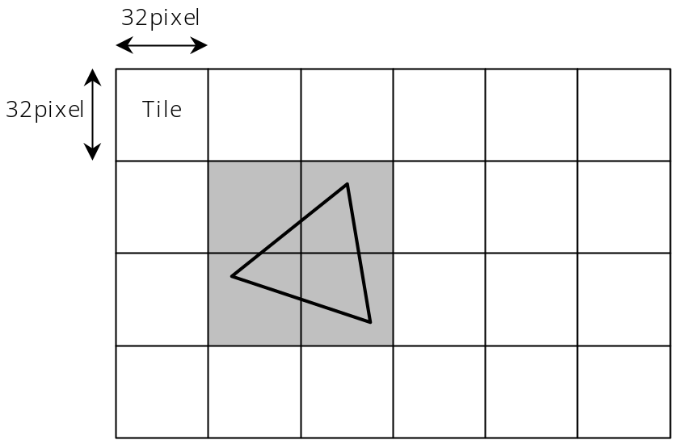
Tile architecture
PowerVR breaks up screen region into 32x32
tiles

Slide 17
Tile accelerator (TA)
Bucket sorts vertices into tiles
Maintains an on-chip “region array” containing current pointers for each tile
Converts vertex data into infinite planes

Slide 18
Triangle setup
Calculates polygon surface equations and texture equations
~25 clock cycles / vertex
  4 million vertices / second
Notes:
The Triangle Setup block consists of the ISP SETUP FPU and the TSP SETUP FPU. this block calculates the polygon surface equations and the texture and shading pa-rameters.
The ISP SETUP FPU calculates the parameters A, B, and C for the surface equation Ax + By + C from the coordinates of three vertices based on the following adjoint ma-trix.

Slide 19
Image synthesis processor (ISP)
Does depth sorting of triangles in a tile
Processes all 1024 pixels in a tile in parallel
Notes:
The ISP performs on-chip depth sorting for triangles without requiring an external Z buffer. The ISP works on 32 x 32 Tiles, and performs its processing in a number of clock cycles equivalent to the number of lines in one triangle. All 1024 screen pixels located in a Tile are processed in parallel.
The processed pixels are sent to the Span RLC, which executes Run Length Encod-ing on 32 pixels in parallel in each clock cycle and sends the result to the Span Sorter. This approach maximizes the data transfer speed between the ISP and the TSP, and lessens the demand for buffering between these two modules.

Slide 20
Texture and shading processor (TSP)
Defers texturing until visibility is determined
Performs texture shading and processing
Notes:
The TSP performs texture and shading processing, and draws in the Tile accumula-tion buffer. Once all Tiles have been drawn, the TSP writes the contents of the accumulation buffer to texture memory. The TSP has a local cache for parameters that have been calculated, which is used to minimize the recalculation of parameters by taking advantage of consistencies between visible polygons.
There is a 64  64-bit texture cache for normal texels or the VQ texture code book, and a 64  64-bit texture cache for VQ texture indices, for a total of 128  64 bits.
The TSP performs perspective compensation for all texture and shading elements, U, V, Alpha, R, G, B, and Fog.

Slide 21
Basic vertex types
Opaque
Opaque punch through
Translucent
Opaque modifier volume
Translucent modifier volume

Slide 22
Texture formats
VQ-compressed
Twiddled vs. non-twiddled
2 KB page size in texture memory
Notes:
One type of Twiddled format texture is a compressed texture data format that is compressed from 1/3 to 1/8 the normal size by a method called "VQ (Vector Quanti-zation) compression." Textures stored in this format are called "VQ textures." This format is supported only for square RGB pixel format. The VQ texture specification is made through "VQ compressed" in the Texture Control Word. (Refer to section 3.7.9.3.)
A VQ texture consists of two types of data, an "index" and a "code book." The rela-tionship between the index and the code book is similar to the relationship between palette texture data and palette data. The index indicates 2 texels (H)  2 texels (V) of the texture prior to compression, through a code book number. The code book is a grouping of units of data for four texels (64 bits), and usually consists of 256  64 bits. The four-texel data of the code book is expanded in a reverse "N" shape, similar to Twiddled format.
The size of the index is specified in the UV size of the texture in the TSP Instruction Word. In other words, the texture size that is actually drawn is about twice the speci-fied size in both the horizontal and vertical directions.

Slide 23
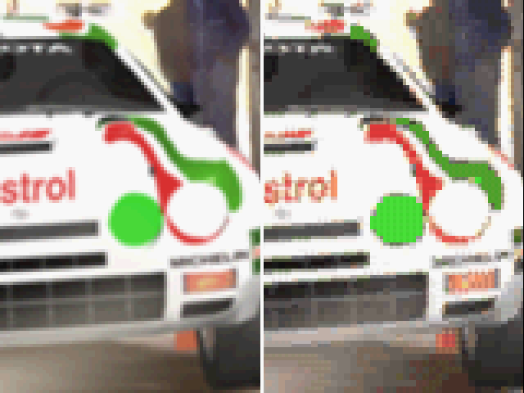
An unfair
VQ compression example
before
after

Slide 24
Texturing methods
Mipmaps supported
Point, bilinear, trilinear, anisotropic
Bump mapping
Color depths
  4 bit, 8-bit with 8-bit palette
  555, 565, 5551, 4444 RGBA
  422 YUV

Slide 25
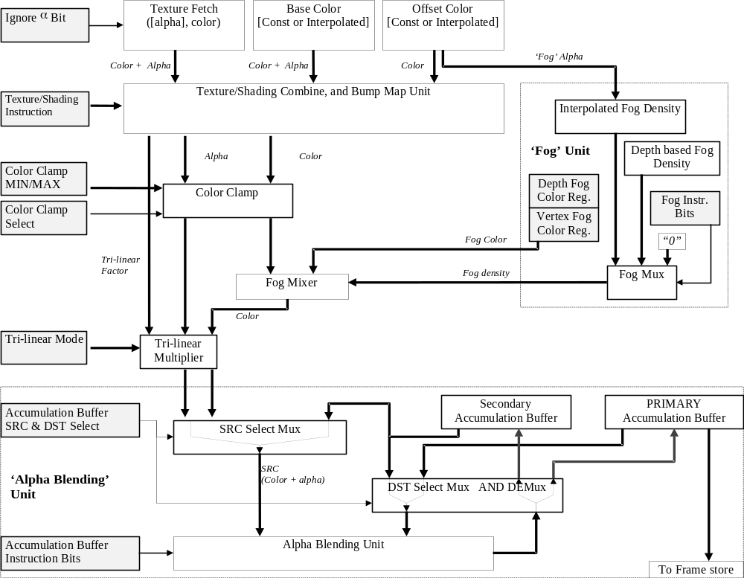

Slide 26
Color blending
Secondary
Accumulation Buffer
PRIMARY
Accumulation Buffer
Accumulation Buffer
SRC & DST Select
SRC Select Mux
SRC
(Color + alpha)
‘Alpha Blending’ Unit
DST Select Mux AND DEMux
Accumulation Buffer
Instruction Bits
Alpha Blending Unit
To Frame store

Slide 27
Graphics: Fog
Per-vertex, as an offset color value
Lookup-table fog
  128 on-chip entries

Slide 28
Graphics: Blending modes
1. Texture, base color, offset color …
  Can be added, multiplied, inverted, etc.
  Resulting color can be clamped
2. Mixed with fog ...

Slide 29
Graphics: Blending modes
3. Blended into one of two accumulation buffers
  Source can be color from fog output or one of the accumulation buffers
  Destination is an accumulation buffer
Notes:
Normally, drawing pixel data for individual Tiles is drawn in a buffer called the "Pri-mary Accumulation Buffer." Another buffer, called the "Secondary Accumulation Buffer," is provided in order to permit the treatment of the result of overlapping multi-ple polygons as a single polygon.
The Secondary Accumulation Buffer is typically used for the following:
• Translucent polygons that have been subjected to trilinear filtering
• Translucent polygons that are Bump Mapped + Textured polygons

Slide 30
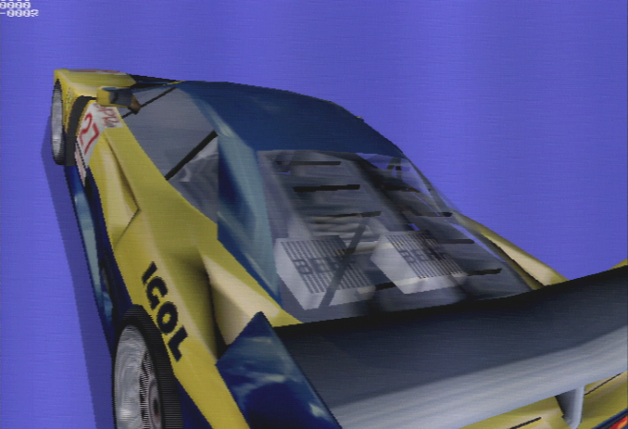
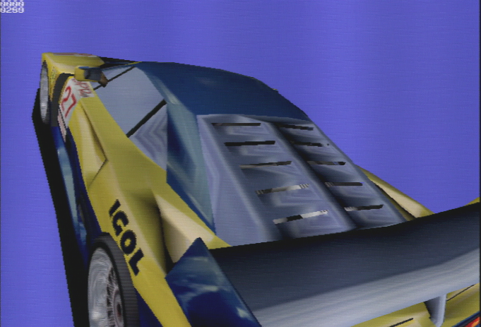
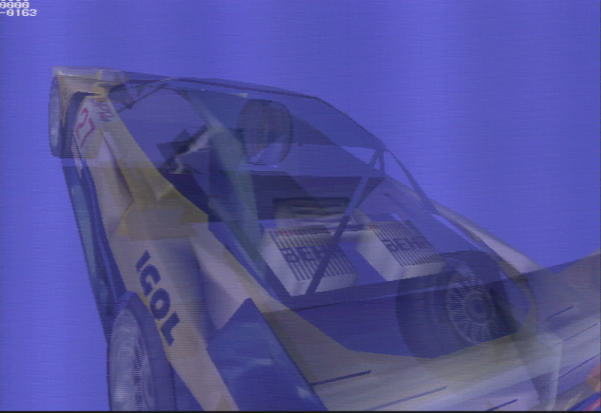
Alpha blending
Alpha-Blending sample

Slide 31
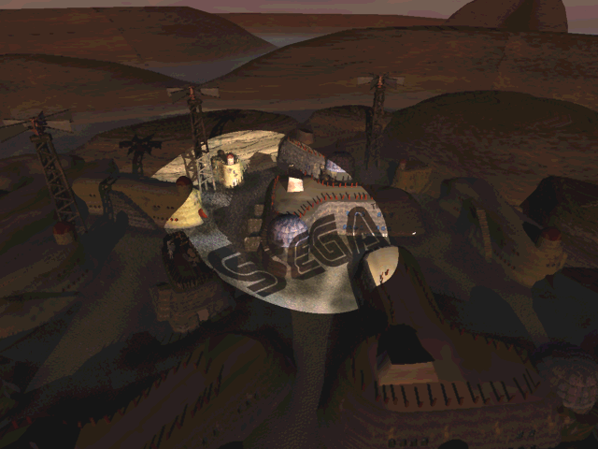
Modifier volumes
Modifies
blending
properties
of opaque/
transparent
objects

Slide 32
Graphics: Real application performance
~1.5 million polys/sec
  Hither clipping, texturing and lighting
  ~1 translucent object per pixel
  2 million estimated with data reorganization
VQ compression improves speed ~10%
Twiddled mipmaps improve speed ~20%

Slide 33
SH-4
Hitachi part number: SH-7091
200 MHz internal, 100 MHz external
8 KB instruction cache
  256 cache lines, 16 instructions/line
16 KB data cache
  512 cache lines, 32 bytes/line
Little endian
  Intel-style; LSB nearest zero memory location
Notes:
The main CPU is a Hitachi SH4, which accepts a 33.3MHz clock signal from the system and, by means of an internal PLL, operates at 1.8V/200Mhz internally and at 3.3V/100MHz for the external bus. The SH4 is primarily responsible for processing concerning the game sequence, AI, 3D calculations, and issuing 3D graphics instructions. In addition, the SH4 also provides a general-purpose serial port with a FIFO buffer for use by external I/O devices. The serial port uses start-stop synchronization, and supports a maximum transfer speed of 1.5625Mbps.

Slide 34
SH-4: 3D math support
Pipelined vector multiplication instruction
4 fmuls + 3 fadds in 1 cycle
16 fmuls + 12 fadds in 4 cycles
At 200 MHz that’s 1.4 GFlops

Slide 35
SH-4: Cache control
Selecting bits 101 in A[31:29] makes pointer non-cacheable
  0x80000000 - 0x8FFFFFFF: cacheable (P1)
  0xA0000000 - 0xAFFFFFFF: non-cacheable (P2)
See sg_Cache.h

Slide 36
SH-4: Store queue
Two 32-byte queues for writing from SH-4 to system memory
Writing
  MOV data to 0xE0000000 - 0xE3FFFFFF
Flushing
  PREF from 0xE0000000 to 0xE3FFFFFC

Slide 37
SH-4: Real application performance
~28 clock cycles to fill a cache line
5% transforming vertices
11% queueing and writing vertices and texture data to memory
11% lighting
2% calculating node hierarchies (67 nodes/model)

Slide 38
Peripheral bus
Code name: Maple
2 Mbits/sec
Four external ports
Keyboard, controller supported now

Slide 39
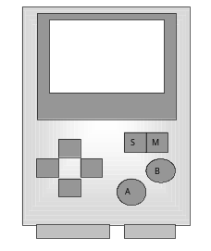
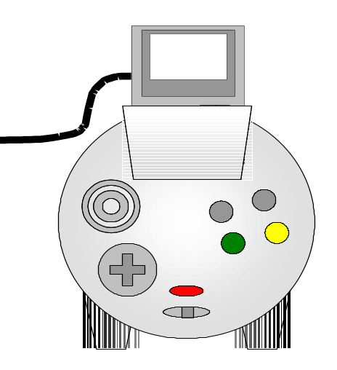
Visual Memory Unit
128 KB of flash RAM
  64 KB of code space
  64 KB data storage space
Sanyo LC86 series CPU
For save game files and
small apps
Display can be accessed
when VMU is docked

Slide 40
Storage media
6x - 12x CAV CD-ROM (“GD-ROM”)
  Manufactured by Yamaha and Samsung
Double density format
  Inner ring contains CD audio stub
~1 GB of data storage
Seek time ~270 ms for 1/3 stroke
  N.B. Spec can be 400 ms or more

Slide 41
Modem
56 Kbps software modem(RJ11)
  In every Dreamcast sold in US
  Digital-analog converter
  Error correction and processing runs on the SH-4
    ~10% hit for DSP processing

Slide 42
Audio system
64 channel PCM/ADPCM
2 MB audio memory
ARM7 controller core
  All integer processing
Yamaha AICA effects DSP
Notes:
The KATANA System can generate stereo output from the 64-channel PCM/ADPCM sound source that is built into the audio chip, and also supports various effects through the sound CPU and DSP that are also built into the chip. This output can also be mixed with sound data that is output from the GD-ROM. The system and the sound CPU and DSP all share a common wave memory, which has a 2MB capacity in the base system. (This capacity can be expanded to 8MB for development work.) The MIDI interface is also supported for development work as the audio peripheral interface.
The stereo sound that is generated by the audio system passes through an audio DAC/AMP, and is then output on the RCA connector and extended VGA connector, along with the video output that is generated by the graphics system.

Slide 43
Development environment: hardware
Set 5.24: “final” development hardware
  SCSI debug adapter (Adaptec card required)
  4 GB internal SCSI drive
“Sound box”
GD Writer
GD Duplicator

Slide 44
Development environments: software
Integrated development environments
  Metrowerks CodeWarrior IDE
  Microsoft WindowsCE for Dreamcast
Command-line compilation environments
  Gnu C compiler/linker
  Hitachi C compiler/linker
  Codescape source-level debugger
GD-Workshop file system emulator

Slide 45
Development environments: middleware
Duck TrueMotion 2 video codec
CRI MPEG video codec
PC-based audio processing tools (audio64 library only)
Macintosh-based audio development environment (manatee library only)

Slide 46
Current performance recommendations 1
1. Acknowledge the SH-4 cache
2. Avoid multiple superimposed levels of translucency
  Replace with punch-through
3. Transfer as little data as reasonable between subsystems
4. Write your own optimized lighting/texturing/rendering loop with these factors in mind

